Slide 1
Network Analysis
By Caylan Barnes &
Bryan Mileski

Slide 2
Milestone 1: Setup & Preparation
Objective:
Analyze network traffic to identify the attackers' IPs, botnet behavior, and C2 communication.
Environment:
Kali Linux VM
Imported CTU-13 PCAP dataset
Conducted log-based forensic review
Zeek, for botnet network traffic analysis to uncover
Attacker IP addresses or infected machines
C2 Channels (IRC, HTTPS, high ports)
Evidence and malware propagation
Signs of spam or data exfiltration
Wireshark
To extract files from pcap file and save suspicious intact files to calculate its hash
Virus Total
Identify any malicious files by searching their hashes

Slide 3
Dataset
PCAP & Hash Verification
Evidence File:
Botnet-capture-20110815-fast-flux.pcap
Hashes:
MD5: ded5f0029af0bcb71f4dc1116b9a2086
SHA-1: 66e32f7867851ca26d3b46b5798d818b6770c1fe
SHA-256: b04dfbdcb5735e64ea28ba801912c55395efca1c69ab0ac5c2672ebfd372a
We used the cryptographic hashes to verify that the PCAP is authentic and unmodified

Slide 4
Milestone 2: Initial Network Survey
Findings
Top Source IP:
88,049 connections with 147.32.84.165
Top Destination IPs:
64162 connections with 184.173.217.40
4,820 connections with 147.32.80.9
Top protocols (in order)
80,232 connections with unidentified protocols, dns, http, ssl, smtp, dce_rpc, and rdp

Slide 5
Milestone 2
Custom C2 Channel
Evidence:
676 connections to IP 212.117.171.138
Using unusual high port 65500
Contains long-lived TCP sessions
No associated service banner, likely encrypted or proprietary protocol
Interpretation:
Attackers often use obscure high ports to avoid detection. We noticed that the persistent connections here indicated a secondary C2 channel. The consistent communication with a single IP on a non-standard high port strongly suggested a stealthy custom command channel.

Slide 6
Milestone 2
SMTP Traffic
Evidence:
13,204 SMTP (port 25) connections
140 secure SMTP (port 587) connections
Normal client machines rarely generate large outbound email traffic
Behavior aligns with botnet-driven spam or phishing campaigns
Interpretation:
We concluded that the infected host was likely being used as a spam relay or email-distribution bot, contributing to malicious campaigns or data exfiltration. The abnormal volume of email traffic indicated that the host was compromised as part of the botnet operations.

Slide 7
Milestone 2
SMB, NTLM, DCE-RPC Activity, Worm Behavior
Evidence:
124-133 internal connections using Windows-sharing protocols
These protocols are commonly abused in worm propagation
Early Conficker-family malware used these exact channels to spread
Interpretation:
This evidence suggests the bot attempted a local network infection to expand the botnet's footprint, scanning or exploiting vulnerable Windows hosts. SMB/NTLM activity indicates possible lateral movement within the local network.

Slide 8
Milestone 2
DNS Abnormalities & Fast-Flux Indicators
Evidence:
4,821 outbound DNS queries
4,891 DNS service events
Queries heavily directed at 147.23.80.9 (DNS server)
Domains rotate IPs frequently, which is a characteristic of fast-flux
Fast-flux is used by botnets to hide C2 systems behind constantly changing IPs
Interpretation:
This pattern strongly matches DGA (Domain Generation Algorithm) behavior, used by botnets like Conficker to evade takedown. We concluded the massive DNS traffic and rapidly changing domains revealed the behavior that was used to conceal the botnet infrastructure.

Slide 9
Milestone 2
Encrypted C2 Over HTTPS
Evidence:
64,162 connections to 184.173.217.40 on port 443
Far beyond normal web-browsing activity
C2 encryption allows malware to hide inside TLS traffic
HTTPS traffic cannot be easily inspected without TLS keys
Interpretation:
We concluded that the malware likely used HTTPS as its main encrypted communication channel for sending system data and to receive commands. The bot relied on HTTPS for stealthy, encrypted command-and-control communication.

Slide 10
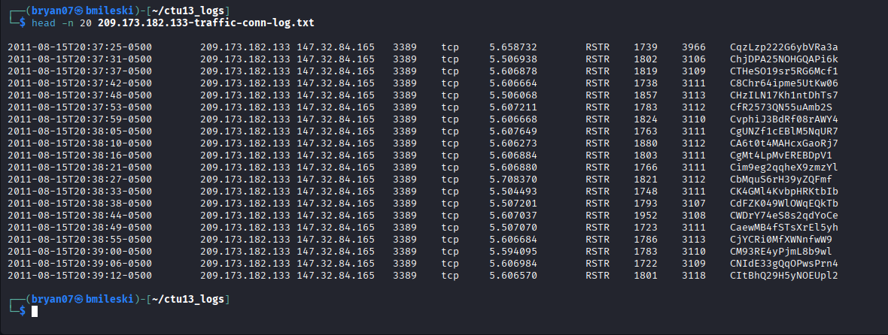
Milestone 3: Attacker Identification
147.32.84.165 is the IP some of the most documented connections
Each connection is initiated at roughly 5 second intervals looking at timestamp on left of top screenshot
More automated, than human browsing
Connection state field is "RSTR", meaning the responder resets the connection, rather than terminating it like normal
209.173.182.133 is communicating on port 3389, standard for Remote Desktop Protocol
This activity started on Mon Aug 15 8:37 PM

Slide 11
Milestone 4: Reconstructing attack methodology
Timeline of suspicious activity:
Mon Aug 15 10:19:51 AM 2011 : 147.32.84.165 sends GET requests to 94.63.149.152 for a suspicious uri called /rus.php
Mon Aug 15 10:21:58 AM to 11:15:53 AM 2011 : Responder 91.220.0.52 sends POST requests of more than 200,000 bytes to suspected infected host 147.32.84.165 a total of 5 times.
Mon Aug 15 02:49:09 PM 2011 : 147.32.84.165 sends GET request to 60.190.223.75 for a suspicious download called /p/out/kp.exe
Mon Aug 15 08:37:25 – 08:43:51 PM 2011 : 209.173.182.133 initiates connections with 147.32.84.165 every 5-6 seconds through RDP protocol

Slide 12
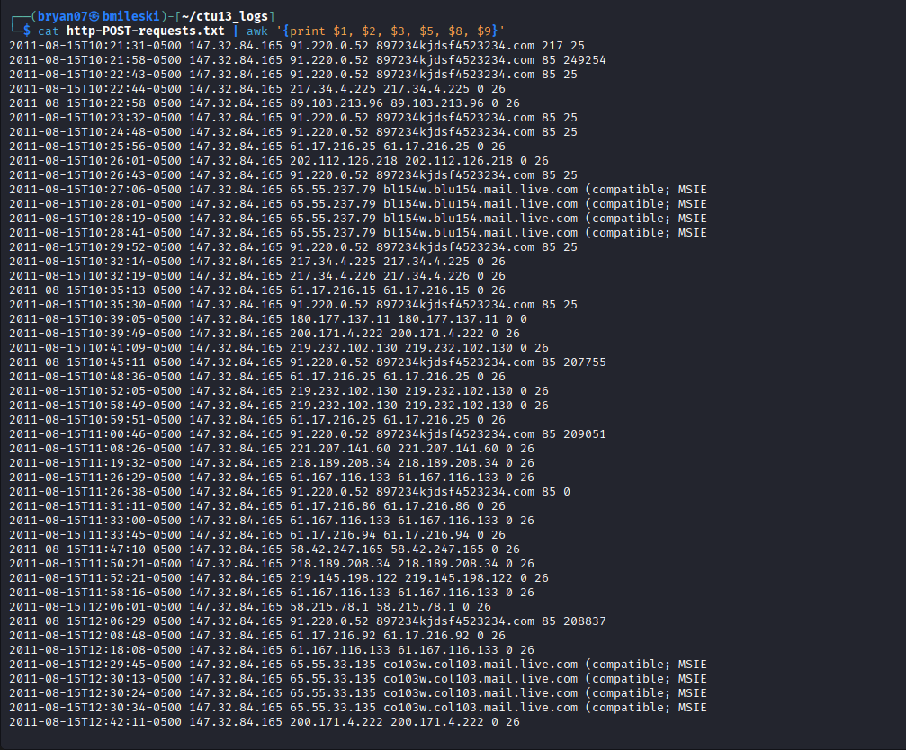
Milestone 5: Data Exfiltration
Following screenshot contains parsed fields from http.log and showing only POST requests
The last 2 columns show orig_bytes and resp_bytes
From time to time there is a sharp increase in byte size of messages, potentially a sign of data exfiltration
Random host names are shown, which could be malware-generated

Slide 13
Milestone 6: Malicious File Carving
The process
Open Wireshark
Go to 'File' top left -> select 'Open'
Locate your pcap file and select it
Go back to 'File' top left -> 'Export Objects'
In our case, we selected 'HTTP' stream
In small pop-up window, filter for connection with suspicious file by looking for the host it was from and select it to open and save it to your file system
Go to linux terminal to find the file
Type 'sha256sum (filename)'
Copy the hash it gives you
Go to VirusTotal website, and paste the hash in search bar
Results shows you how many vendors have rated it as malicious and what they labeled it as

Slide 14
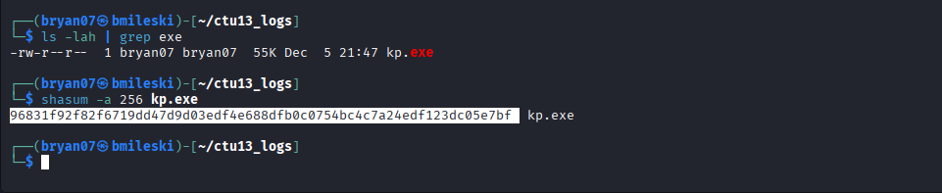
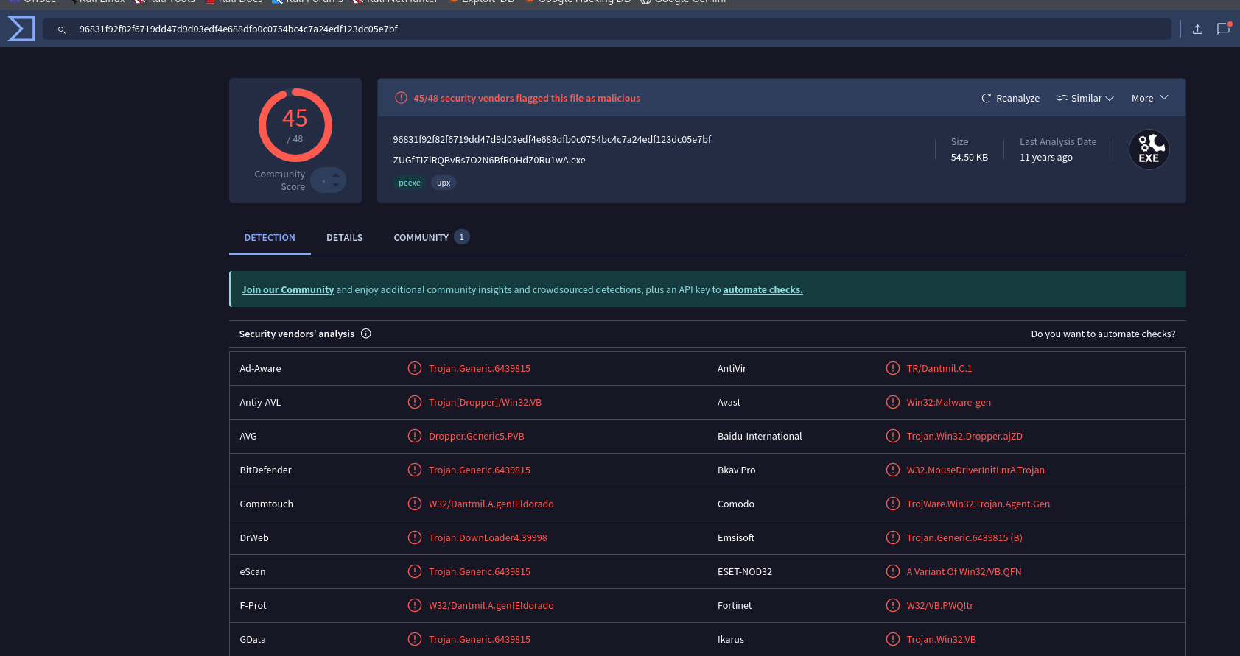
Milestone 6: Malicious File Carving
Suspicious file name: kp.exe
Top figure: calculating SHA256 hash of malicious file
Bottom figure: results from VirusTotal stating that 45/48 vendors classified it as malicious

Slide 15
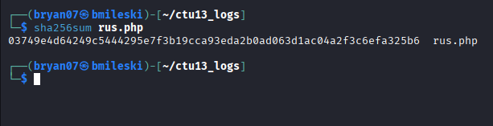
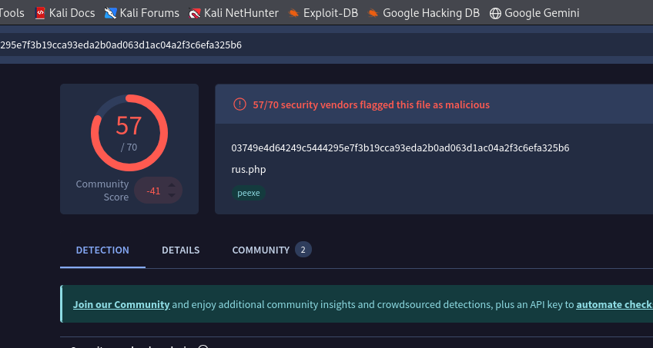
Milestone 6: Malicious File Carving
Suspicious file name: /rus.php
Left figure: calculating SHA256 file hash
Right figure: hash is searched on VirusTotal, 57/70 vendors rated it as malicious

Slide 16
Milestone 7: Final report
147.32.84.165
Initiated many connections that occurred at steady intervals of very 5 or 30 seconds, not characteristic of human browsing, and is most likely C2C beaconing
Tried to request malware files such as /rus.php or kp.exe
209.173.182.133
Tried to connect to already compromised 147.32.84.165 at repeated intervals through RDP, all connections were resetted by 147.32.84.165 instead of being gracefully terminated like normal
Interpretation:
This could be a multi-stage attack. The attacker compromised 147.32.84.165 which propagated malware activity and C2C beaconing activity to maintain a persistent channel to the C2 server, allowing the attacker to get a foothold in the network. For the next stage, the attacker, 209.173.182.133, tried to get full control of the network through RDP by connecting to 147.32.84.165. Through RDP, the attacker can escalate their privileges and better explore the network, look for valuable files and sensitive information, configure backdoors, and disable security.

Slide 17
Thank you! Any Questions?

